Slide 1


Department of Electronics and Communication Engineering
B.E – ECE ( 2 Year B Section)
PROJECT BASED LEARNING REVIEW 1 AY 2026-27 ODD SEMESTER
Title of the Project
AI-Based Smart Road Safety and Emergency Response System
i
Presented By |  | Under the Mentoring of | Mentor – (Company)
MAHALAKSHMI S SIDDHARATH S | II YEAR II YEAR |  | NAME: Post: Mail ID: Mob :
 |  | Assistant Professor / ECE Department/CIT | Contact Details:
KALAIYARASI P

Slide 2
TITLE
ABSTRACT
Road accidents often result in fatalities due to delayed emergency response.
This project uses an ESP32, MPU6050, GPS, and GSM to automatically detect accidents and send alerts with the accident location to family members while contacting the ambulance and police.
AI is used to classify accident severity as Minor, Moderate, or Severe, reducing false alerts and improving emergency response efficiency.
Chennai Institute of Technology | ECE | PBL REVIEW 1 | Review | 10/7/2026 | 2

Slide 3
Title
Outcomes
S. No | Base Papers | Problem Identified | Remarks Solutions/Modifications/Suggestions
1 | IoT-Based Smart Accident Detection and Emergency Notification System R. Karthikeyan et al., 2022 | Uses threshold-based accident detection, leading to false alarms. | AI-based accident verification to improve accuracy.
2 | Smart Vehicle Accident Detection and Emergency Response Using IoT, S. Kumar, P. Singh 2023 | Sends alerts without classifying accident severity.
3 | An Intelligent Road Accident Detection and Rescue System Using Machine Learning, A. Sharma, R. Verma,2024 | Lacks intelligent decision-making and emergency prioritization. | AI-assisted emergency response with severity-based alert generation.
AI-based Minor/Moderate/Severe accident prediction.
.
Chennai Institute of Technology | ECE | PBL 1 | Review | 10/7/2026 | 3

Slide 4
Title
Objectives
Detect road accidents automatically.
Reduce emergency response time.
Share accident location with family.
Automatically call ambulance and police.
Reduce false accident alerts.
Predict accident severity using AI.
Improve road safety.
Chennai Institute of Technology | ECE | PBL 1 | Review | 10/7/2026 | 4

Slide 5
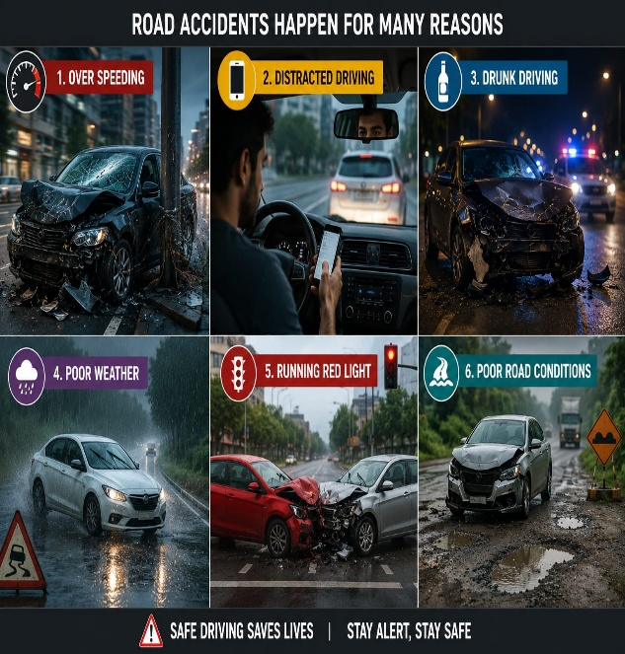
Title
Problem Statements Identified
High false alarm rate.
Every accident receives the same emergency
response.
No accident severity prediction.
Delay in emergency response.
Limited emergency notification.
Chennai Institute of Technology | ECE | PBL 1 | Review | 10/7/2026 | 5

Slide 6
Title
SOLUTIONS / MODIFICATIONS
Real-time accident detection using MPU6050.
AI-based accident verification.
Smart Emergency Priority Index (SEPI) for severity assessment.
15-second false alarm cancellation.
Automatic SMS and emergency service notification.
Live GPS location sharing.
Smart Digital Accident Report generation.
Firebase cloud storage for secure record management
Chennai Institute of Technology | ECE | PBL 1 | Review | 10/7/2026 | 6

Slide 7
Title
Subjects Integration
Embedded Systems
Machine Learning
IoT
Wireless Communication
Microcontrollers
Digital Signal Processing
Sensor Technology
Chennai Institute of Technology | ECE | PBL 1 | Review | 10/7/2026 | 7

Slide 8
Title
Hardware Components Purchased
ESP32
MPU6050
LCD Display
GPS Module (Neo-6M)
Buzzer
Power Supply
Jumper Wires,Breadboard
Chennai Institute of Technology | ECE | PBL 1 | Review | 10/7/2026 | 8

Slide 9
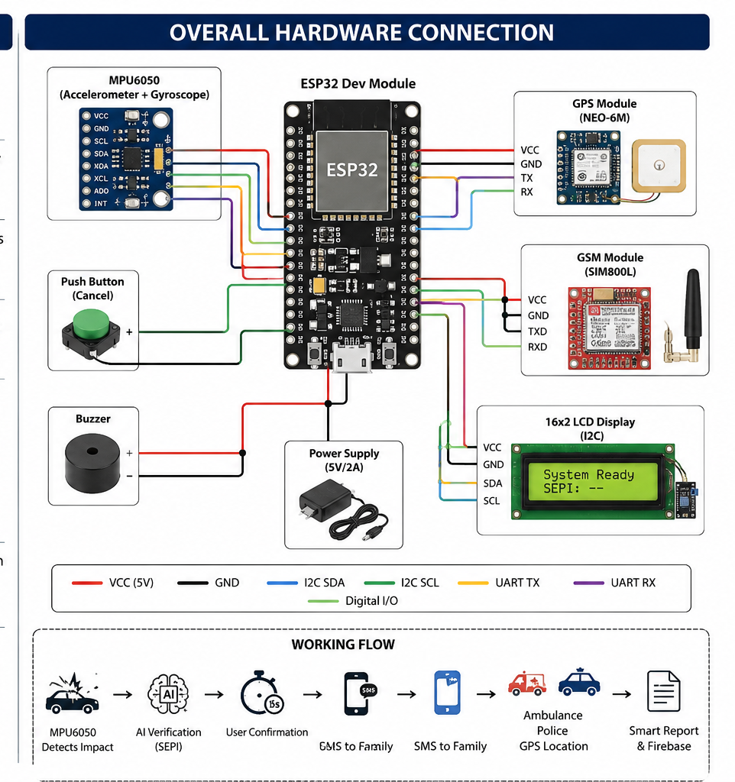
Title
Overall System Architecture
Chennai Institute of Technology | ECE | PBL 1 | Review | 10/7/2026 | 9

Slide 10
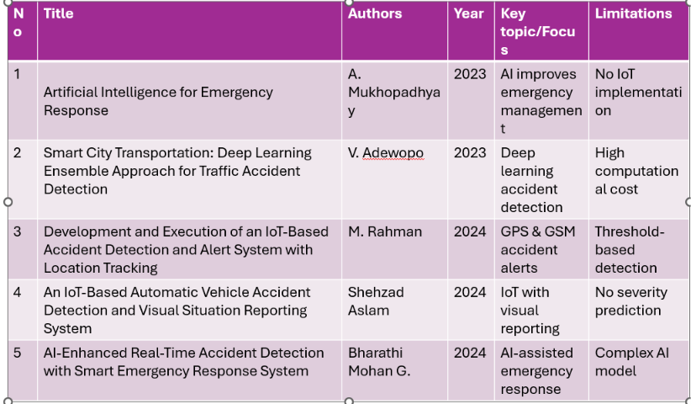

Slide 11
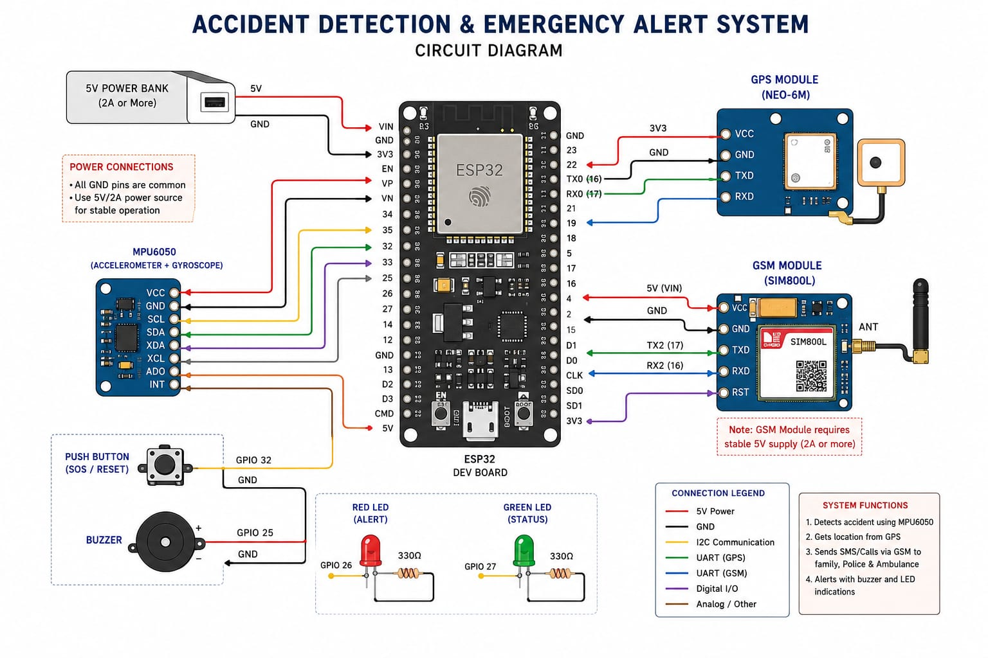
Title
Circuit Diagrams
Chennai Institute of Technology | ECE | PBL 1 | Review | 10/7/2026 | 11

Slide 12
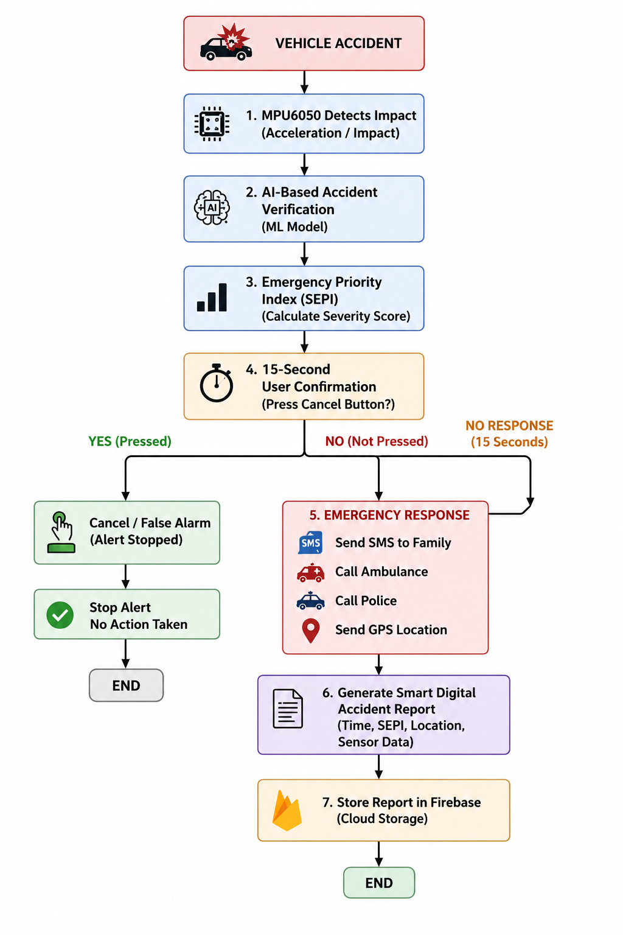
Title
Algorithm / Flowchart
Chennai Institute of Technology | ECE | PBL 1 | Review | 10/7/2026 | 12

Slide 13
Title
Software Development Status
1 | Arduino IDE Setup | finished
2 | ESP32 Programming | Finished
3 | MPU6050 Interfacing | finished
4 | GPS Integration | In progress
5 | GSM Integration | Finished
6 | Accident Detection Algorithm | Finished
7 | AI Model Development | Finished
8 | System testing | Finished
9 | Connection | finished
Chennai Institute of Technology | ECE | PBL 1 | Review | 10/7/2026 | 13

Slide 14
Title
Hardware Development Status
✅ ESP32 microcontroller configured and tested.
✅ MPU6050 (Accelerometer & Gyroscope) connected successfully.
✅ GPS module integrated for live location tracking.
✅ GSM module connected for SMS and emergency calls.
✅ LCD display integrated for real-time system status.
✅ Push button implemented for 15-second user confirmation.
✅ Power supply and complete hardware wiring verified.
✅ Individual hardware modules tested successfully.
Chennai Institute of Technology | ECE | PBL 1 | Review | 10/7/2026 | 14

Slide 15
Title
Project Timeline
Week 5
GSM Integration
Week 6
AI Model Development
Week 7
Testing
Week 8
Documentation
Week 1
Literature Survey
Week 2
Hardware Procurement
Week 3
Sensor Interface
Week 4
GPS Integration
Chennai Institute of Technology | ECE | PBL 1 | Review | 10/7/2026 | 15

Slide 16
Title
Project Completion Percentage
Literature Survey – 100%
Hardware Procurement – 100%
Sensor Interface – 80%
Software – 80%
AI Model – 100%
Testing – 50%
Overall Completion – 100%
Chennai Institute of Technology | ECE | PBL 1 | Review | 10/7/2026 | 16

Slide 17
Team Member Responsibilities
Member 1
Literature Survey
Hardware Integration
Circuit Design
Hardware Testing
Member 2
Software Development
AI Model Development
GPS & GSM Integration
Documentation & Presentation
Chennai Institute of Technology | ECE | PBL 1 | Review | 10/7/2026 | 17

Slide 18
Next Milestone (Review 2)
Complete AI model.
Integrate GPS.
Integrate GSM.
Perform accident testing.
Validate AI accuracy.
Chennai Institute of Technology | ECE | PBL 1 | Review | 10/7/2026 | 18

Slide 19
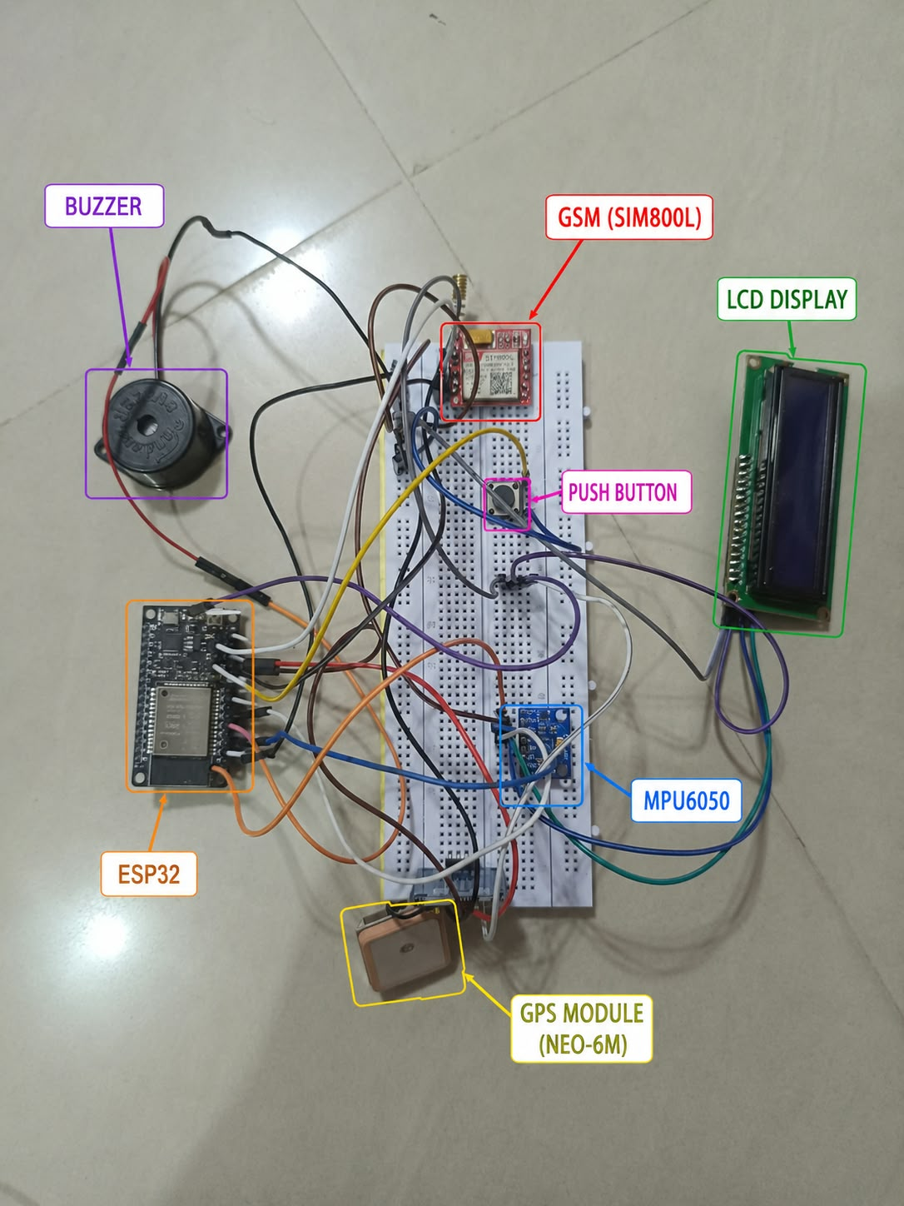

Slide 20
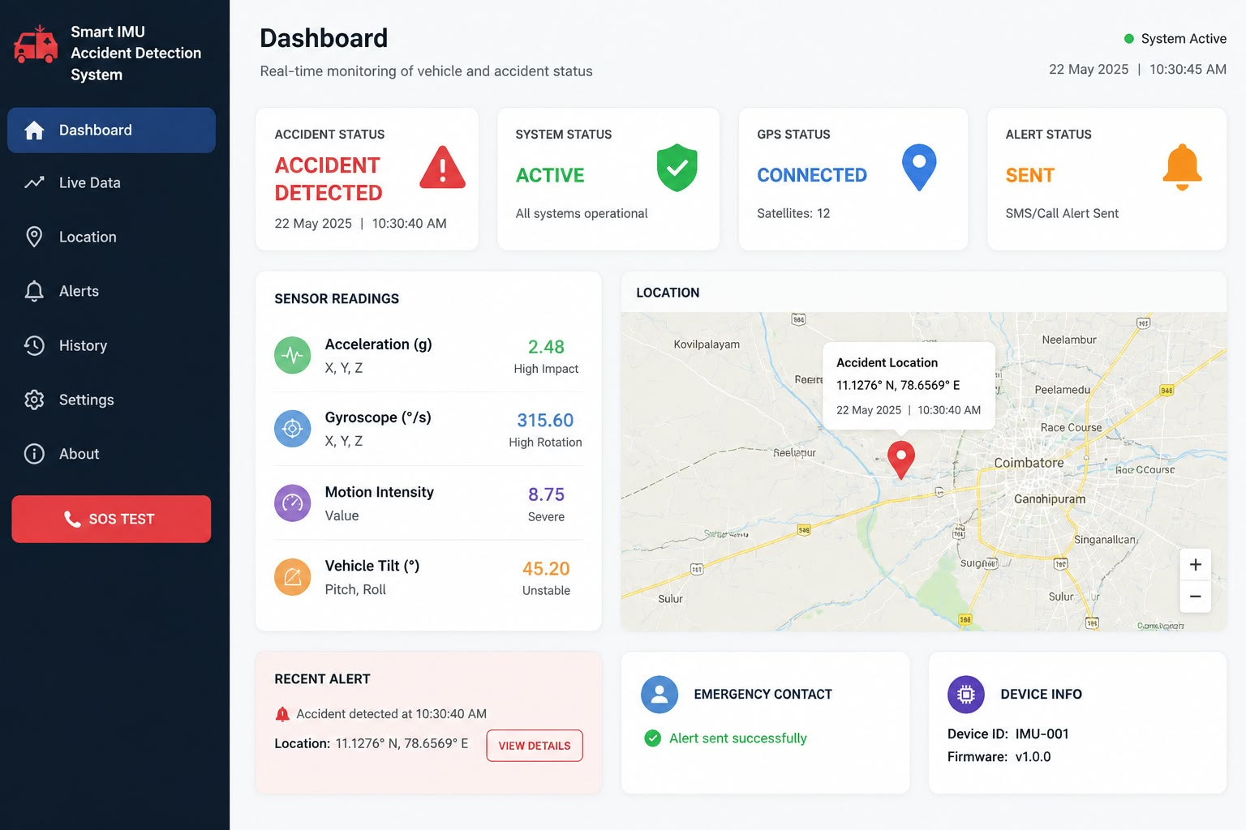

Slide 21
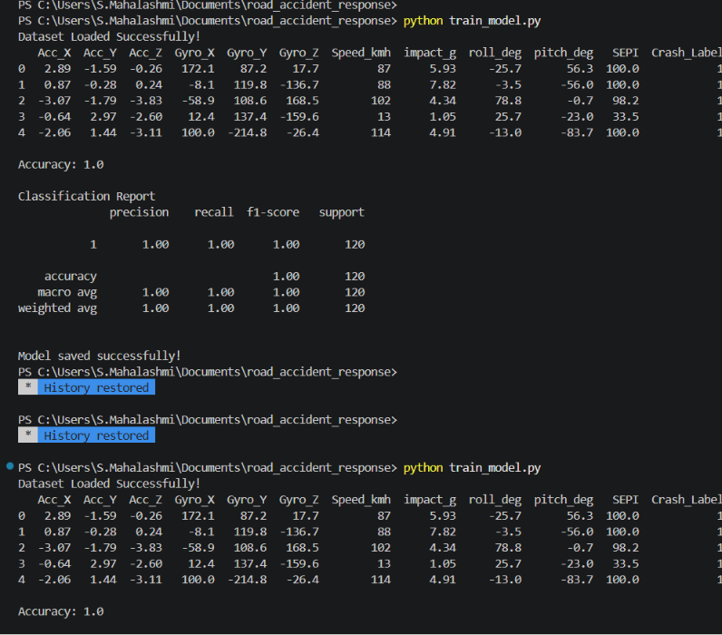
VERIFIED OUTPUT

Slide 22

Chennai Institute of Technology | ECE | PBL 1 | Review | 10/7/2026 | 22

